Slide 1
Automatic Speech Recognition

Slide 2
The Automatic Speech Recognition Task
One dimension of variation is vocabulary size. Some ASR tasks can be solved with extremely high accuracy, like those with a 2-word vocabulary (yes versus no) or an 11-word vocabulary like digit recognition (recognizing sequences of digits in- digit recognition cluding zero to nine plus oh). Open-ended tasks like transcribing videos or human conversations, with large vocabularies of up to 60,000 words, are much harder.
A second dimension of variation is who the speaker is talking to. Humans speaking to machines (either dictating or talking to a dialogue system) are easier to recogread speech nize than humans speaking to humans.
Read speech, in which humans are reading out loud, for example in audio books, is also relatively easy to recognize. Recognizing the speech of two humans talking to each other in conversational speech, conversational speech for example, for transcribing a business meeting, is the hardest.
It seems that when humans talk to machines, or read without an audience present, they simplify their speech quite a bit, talking more slowly and more clearly.

Slide 3
A third dimension of variation is channel and noise. Speech is easier to recognize if it’s recorded in a quiet room with head-mounted microphones than if it’s recorded by a distant microphone on a noisy city street, or in a car with the window open.
A final dimension of variation is accent or speaker-class characteristics. Speech is easier to recognize if the speaker is speaking the same dialect or variety that the system was trained on. Speech by speakers of regional or ethnic dialects, or speech by children can be quite difficult to recognize if the system is only trained on speakers of standard dialects, or only adult speakers.

Slide 4
General Information
A number of publicly available corpora with human-created transcripts are used to create ASR test and training sets to explore this variation; we mention a few of LibriSpeech them here since you will encounter them in the literature.
LibriSpeech is a large open-source read-speech 16 kHz dataset with over 1000 hours of audio books from the LibriVox project, with transcripts aligned at the sentence level (Panayotov et al., 2015). It is divided into an easier (“clean”) and a more difficult portion (“other”) with the clean portion of higher recording quality and with accents closer to US English.
This was done by running a speech recognizer (trained on read speech from the Wall Street Journal) on all the audio, computing the WER for each speaker based on the gold transcripts, and dividing the speakers roughly in half, with recordings from lower-WER speakers called “clean” and recordings from higher-WER speakers “other”

Slide 5
Automatic speech recognition
What is the task?
What are the main difficulties?
How is it approached?
How good is it?
How much better could it be?

Slide 6
What is the task?
Getting a computer to understand spoken language
By “understand” we might mean
  React appropriately
  Convert the input speech into another medium, e.g. text
Several variables impinge on this (see later)

Slide 7
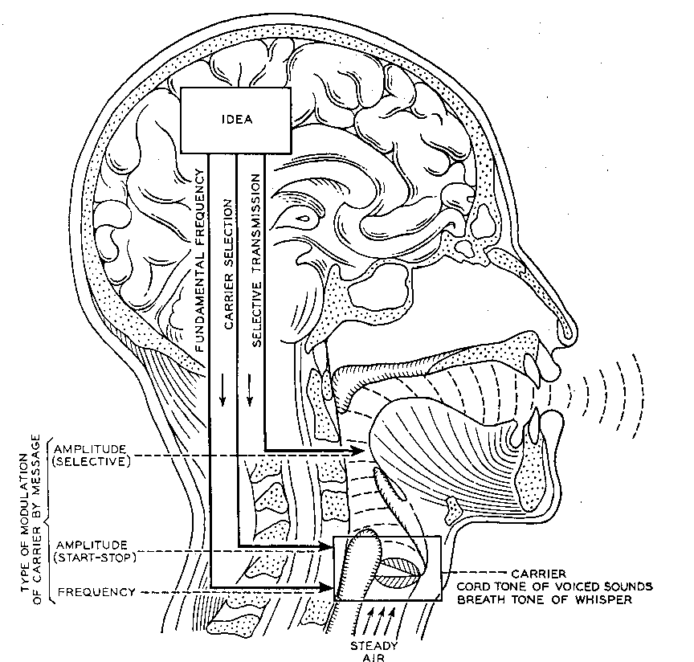
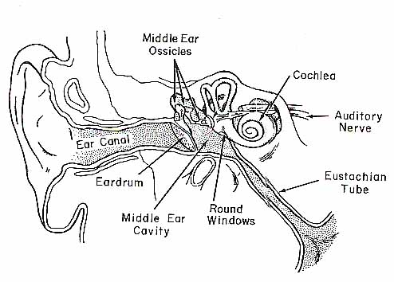

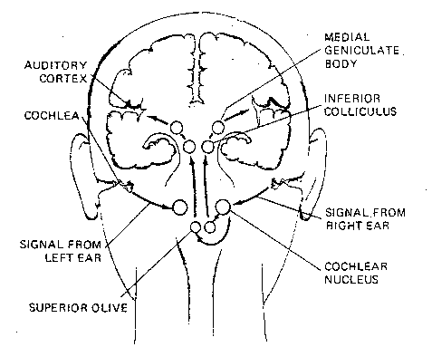
How do humans do it?
Articulation produces
sound waves which
the ear conveys to the brain
for processing

Slide 8
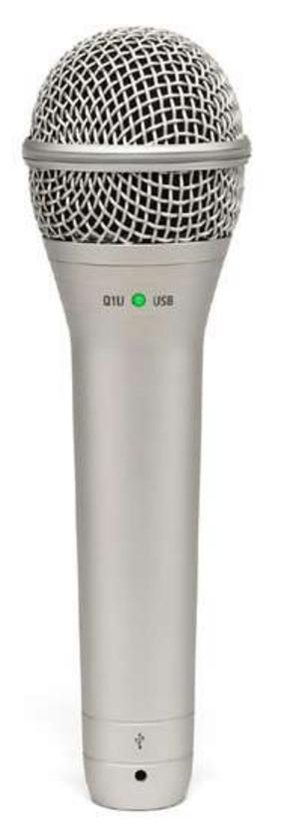
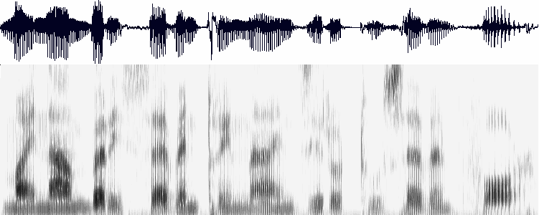
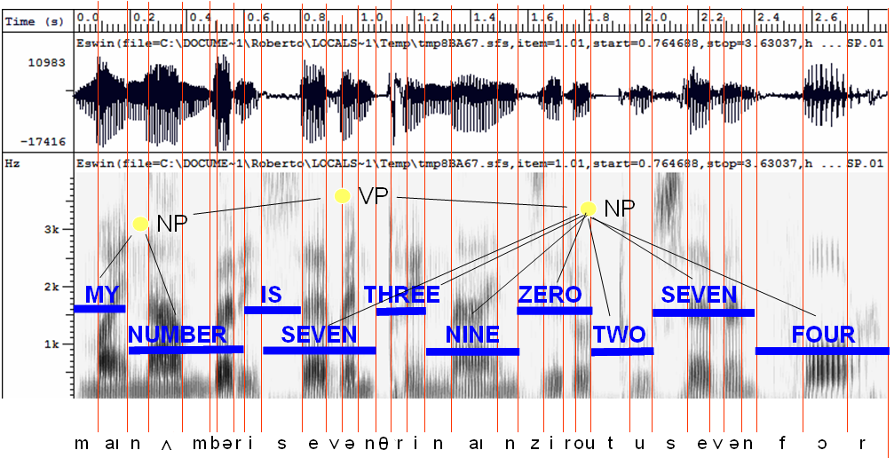
How might computers do it?
Acoustic waveform
Acoustic signal
Digitization
Acoustic analysis of the speech signal
Linguistic interpretation
Speech recognition

Slide 9
What’s hard about that?
Digitization
  Converting analogue signal into digital representation
Signal processing
  Separating speech from background noise
Phonetics
  Variability in human speech
Phonology
  Recognizing individual sound distinctions (similar phonemes)
Lexicology and syntax
  Disambiguating homophones
  Features of continuous speech
Syntax and pragmatics
  Interpreting prosodic features
Pragmatics
  Filtering of performance errors (disfluencies)

Slide 10
Digitization
Analogue to digital conversion
Sampling and quantizing
Use filters to measure energy levels for various points on the frequency spectrum
Knowing the relative importance of different frequency bands (for speech) makes this process more efficient
E.g. high frequency sounds are less informative, so can be sampled using a broader bandwidth (log scale)

Slide 11
Separating speech from background noise
Noise cancelling microphones
  Two mics, one facing speaker, the other facing away
  Ambient noise is roughly same for both mics
Knowing which bits of the signal relate to speech
  Spectrograph analysis

Slide 12
Variability in individuals’ speech
Variation among speakers due to
  Vocal range (f0, and pitch range – see later)
  Voice quality (growl, whisper, physiological elements such as nasality, adenoidality, etc)
  ACCENT !!! (especially vowel systems, but also consonants, allophones, etc.)
Variation within speakers due to
  Health, emotional state
  Ambient conditions
Speech style: formal read vs spontaneous

Slide 13
Speaker-(in)dependent systems
Speaker-dependent systems
  Require “training” to “teach” the system your individual idiosyncracies
    The more the merrier, but typically nowadays 5 or 10 minutes is enough
    User asked to pronounce some key words which allow computer to infer details of the user’s accent and voice
    Fortunately, languages are generally systematic
  More robust
  But less convenient
  And obviously less portable
Speaker-independent systems
  Language coverage is reduced to compensate need to be flexible in phoneme identification
  Clever compromise is to learn on the fly

Slide 14
Identifying phonemes
Differences between some phonemes are sometimes very small
  May be reflected in speech signal (eg vowels have more or less distinctive f1 and f2)
  Often show up in coarticulation effects (transition to next sound)
    e.g. aspiration of voiceless stops in English
  Allophonic variation

Slide 15
Disambiguating homophones
Mostly differences are recognised by humans by context and need to make sense
It’s hard to wreck a nice beach
What dime’s a neck’s drain to stop port?
Systems can only recognize words that are in their lexicon, so limiting the lexicon is an obvious ploy
Some ASR systems include a grammar which can help disambiguation

Slide 16
(Dis)continuous speech
Discontinuous speech much easier to recognize
  Single words tend to be pronounced more clearly
Continuous speech involves contextual coarticulation effects
  Weak forms
  Assimilation
  Contractions

Slide 17
Interpreting prosodic features
Pitch, length and loudness are used to indicate “stress”
All of these are relative
  On a speaker-by-speaker basis
  And in relation to context
Pitch and length are phonemic in some languages

Slide 18
Pitch
Pitch contour can be extracted from speech signal
  But pitch differences are relative
  One man’s high is another (wo)man’s low
  Pitch range is variable
Pitch contributes to intonation
  But has other functions in tone languages
Intonation can convey meaning

Slide 19
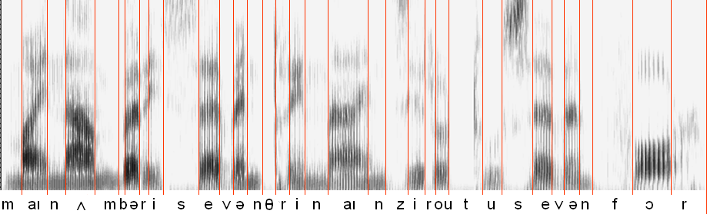
Length
Length is easy to measure but difficult to interpret
Again, length is relative
It is phonemic in many languages
Speech rate is not constant – slows down at the end of a sentence

Slide 20
Loudness
Loudness is easy to measure but difficult to interpret
Again, loudness is relative

Slide 21
Performance errors
Performance “errors” include
  Non-speech sounds
  Hesitations
  False starts, repetitions
Filtering implies handling at syntactic level or above
Some disfluencies are deliberate and have pragmatic effect – this is not something we can handle in the near future

Slide 22
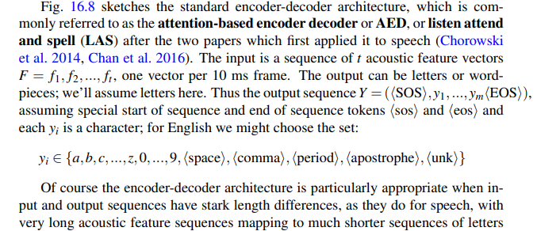
Speech Recognition Architecture
or words. A single word might be 5 letters long but, supposing it lasts about 2 seconds, would take 200 acoustic frames (of 10ms each). Because this length difference is so extreme for speech, encoder-decoder architectures for speech need to have a special compression stage that shortens the acoustic feature sequence before the encoder stage.

Slide 23
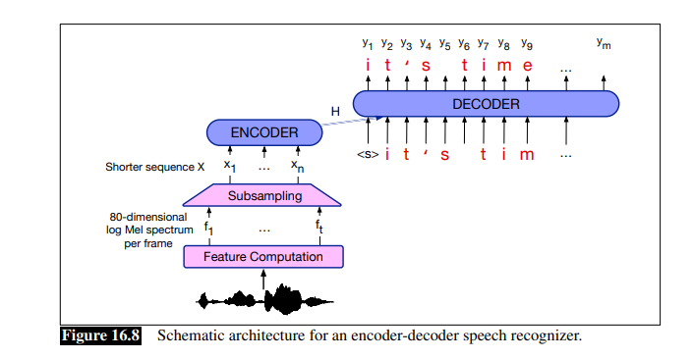

Slide 24
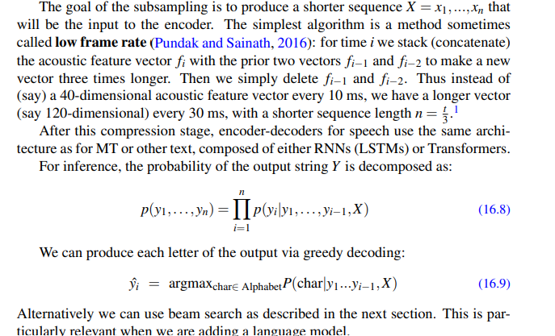

Slide 25
Approaches to ASR
Template matching
Knowledge-based (or rule-based) approach
Statistical approach:
  Noisy channel model + machine learning

Slide 26
Template-based approach
Store examples of units (words, phonemes), then find the example that most closely fits the input
Extract features from speech signal, then it’s “just” a complex similarity matching problem, using solutions developed for all sorts of applications
OK for discrete utterances, and a single user

Slide 27
Template-based approach
Hard to distinguish very similar templates
And quickly degrades when input differs from templates
Therefore needs techniques to mitigate this degradation:
  More subtle matching techniques
  Multiple templates which are aggregated
Taken together, these suggested …

Slide 28
Rule-based approach
Use knowledge of phonetics and linguistics to guide search process
Templates are replaced by rules expressing everything (anything) that might help to decode:
  Phonetics, phonology, phonotactics
  Syntax
  Pragmatics

Slide 29
Rule-based approach
Typical approach is based on “blackboard” architecture:
  At each decision point, lay out the possibilities
  Apply rules to determine which sequences are permitted
Poor performance due to
  Difficulty to express rules
  Difficulty to make rules interact
  Difficulty to know how to improve the system
k
h
p
t
ʃ
tʃ
h
s
s
ʃ
i:
iə
ɪ

Slide 30
Identify individual phonemes
Identify words
Identify sentence structure and/or meaning
Interpret prosodic features (pitch, loudness, length)

Slide 31
Statistics-based approach
Can be seen as extension of template-based approach, using more powerful mathematical and statistical tools
Sometimes seen as “anti-linguistic” approach
  Fred Jelinek (IBM, 1988): “Every time I fire a linguist my system improves”

Slide 32
Statistics-based approach
Collect a large corpus of transcribed speech recordings
Train the computer to learn the correspondences (“machine learning”)
At run time, apply statistical processes to search through the space of all possible solutions, and pick the statistically most likely one

Slide 33
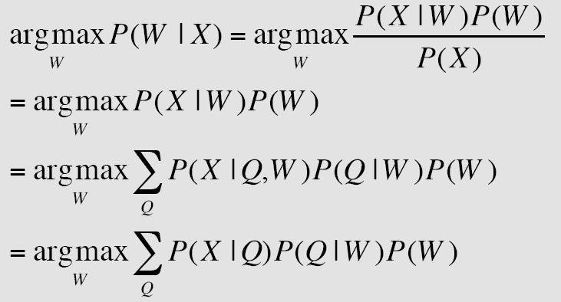
Modern Statistical ASR

Slide 34
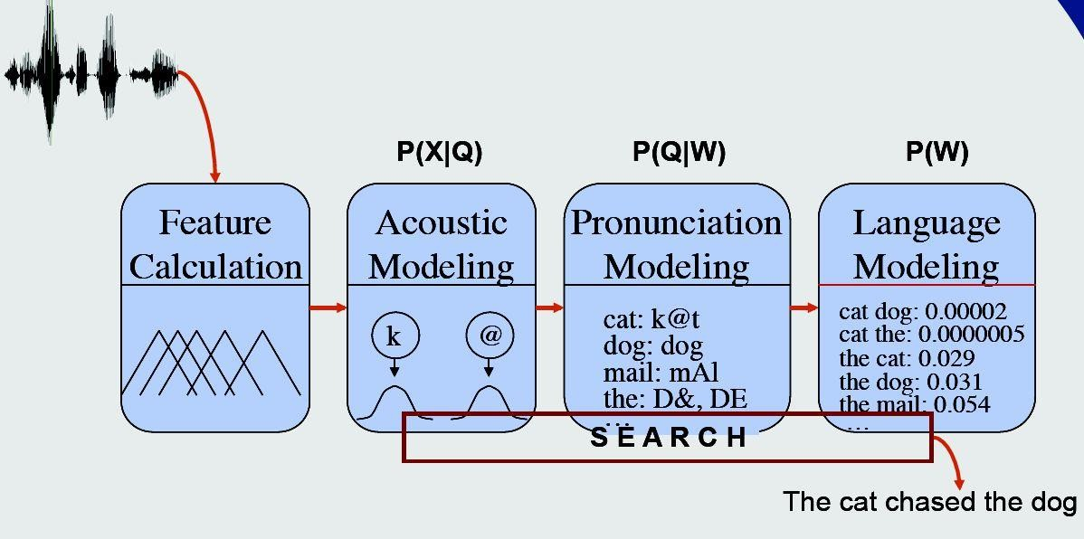

Slide 35
Pronunciation Model
While the pronunciation model can be very complex, it is typically just a dictionary
The dictionary contains the valid
pronunciations for each word
Examples:
  Cat: k ae t
  Dog: d ao g
  Fox: f aa x s

Slide 36
Machine learning
Acoustic and Lexical Models
  Analyse training data in terms of relevant features
  Learn from large amount of data different possibilities
    different phone sequences for a given word
    different combinations of elements of the speech signal for a given phone/phoneme
  Combine these into a Hidden Markov Model expressing the probabilities

Slide 37
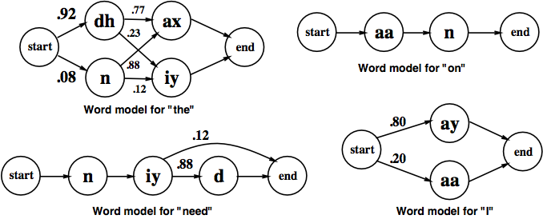
HMMs for some words

Slide 38
Language model
Models likelihood of word given previous word(s)
n-gram models:
  Build the model by calculating bigram or trigram probabilities from text training corpus
  Smoothing issues

Slide 39
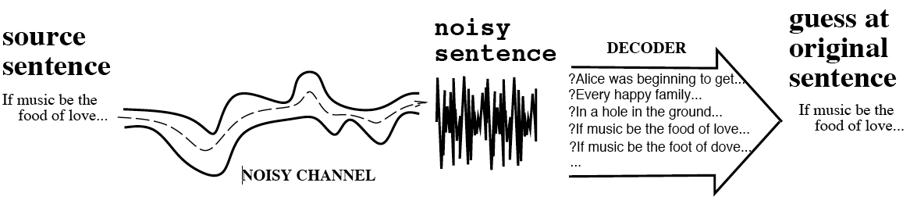
The Noisy Channel Model
Search through space of all possible sentences
Pick the one that is most probable given the waveform

Slide 40
The Noisy Channel Model
Use the acoustic model to give a set of likely phone sequences
Use the lexical and language models to judge which of these are likely to result in probable word sequences
The trick is having sophisticated algorithms to juggle the statistics
A bit like the rule-based approach except that it is all learned automatically from data

Slide 41
Acoustic Model
For each frame of data, we need some way of describing the likelihood of it belonging to any of our classes
Two methods are commonly used
  Multilayer perceptron (MLP) gives the likelihood of a class given the data
  Gaussian Mixture Model (GMM) gives the likelihood of the data given a class

Slide 42
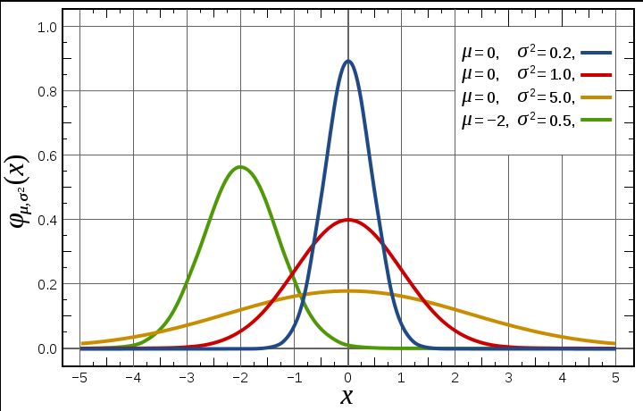

Gaussian Distribution

Slide 43
Evaluation
Funders have been very keen on competitive quantitative evaluation
Subjective evaluations are informative, but not cost-effective
For transcription tasks, word-error rate is popular (though can be misleading: all words are not equally important)
For task-based dialogues, other measures of understanding are needed

Slide 44
Comparing ASR systems
Factors include
  Speaking mode: isolated words vs continuous speech
  Speaking style: read vs spontaneous
  “Enrollment”: speaker (in)dependent
  Vocabulary size (small <20 … large > 20,000)
  Equipment: good quality noise-cancelling mic … telephone
  Size of training set (if appropriate) or rule set
  Recognition method

Slide 45
Remaining problems
Robustness – graceful degradation, not catastrophic failure
Portability – independence of computing platform
Adaptability – to changing conditions (different mic, background noise, new speaker, new task domain, new language even)
Language Modelling – is there a role for linguistics in improving the language models?
Confidence Measures – better methods to evaluate the absolute correctness of hypotheses.
Out-of-Vocabulary (OOV) Words – Systems must have some method of detecting OOV words, and dealing with them in a sensible way.
Spontaneous Speech – disfluencies (filled pauses, false starts, hesitations, ungrammatical constructions etc) remain a problem.
Prosody –Stress, intonation, and rhythm convey important information for word recognition and the user's intentions (e.g., sarcasm, anger)
Accent, dialect and mixed language – non-native speech is a huge problem, especially where code-switching is commonplace

